Slide 1

Web App for relatives of Alzheimer's patients Task 3 and 4
Group Green
Adams, Abu Bakar, Devarasa, Sinnappah, Torresan, Uthayathas, Zemp
Software Engineering and Design, 21.11. 2019, BFH Biel 2019
Technik und Informatik / Medizininformatik
Notes:
Zielgruppe: Angehörige
Krankheit : Alzheimer

Slide 2
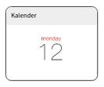
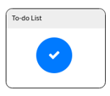
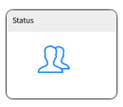
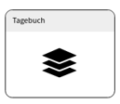
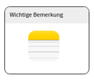
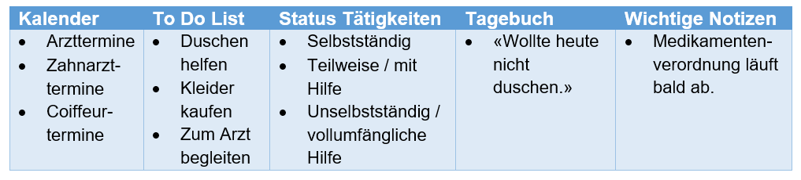
Brief review

Slide 3
Task 3
High-level UML component and deployment diagram
Detailed UML class diagram for main view of our application

Slide 4
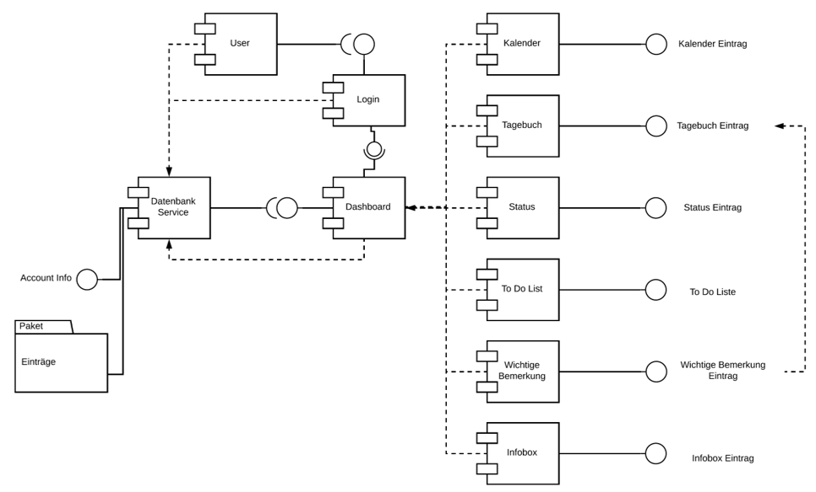
UML component diagram

Slide 5
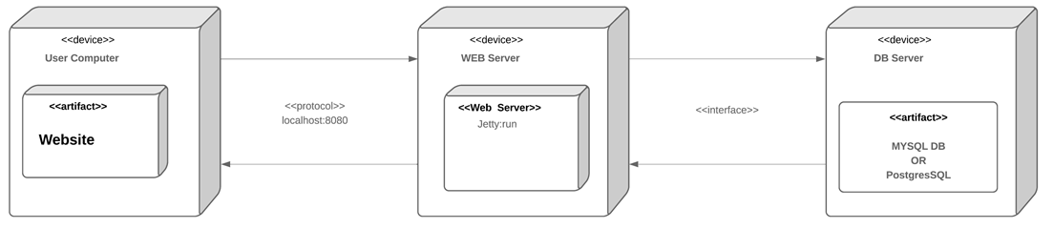
UML deployment diagram

Slide 6
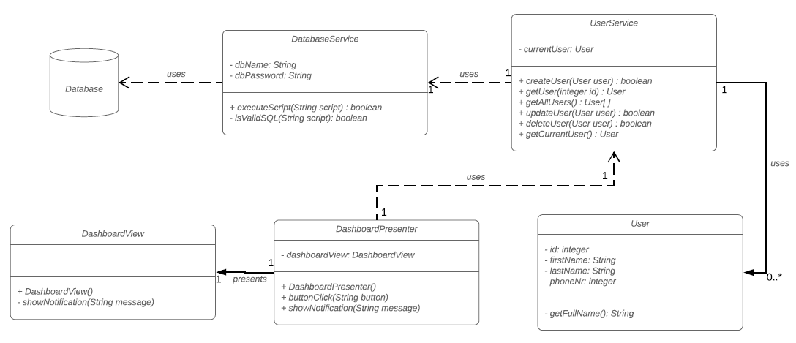
UML detailed class diagram - Dashboard

Slide 7
Task 4
Scrum Setup

Slide 8



Project team: role of group Green
Scrum master
Developers
Project Owner
A. Zemp
S. Adams
M. Abu Bakar
J. Devarasa
T. Sinnappah
E. Torresan
G. Uthayathas
Prof. M. Pfahrer
Prof. Dr. J. Vogel

Slide 9
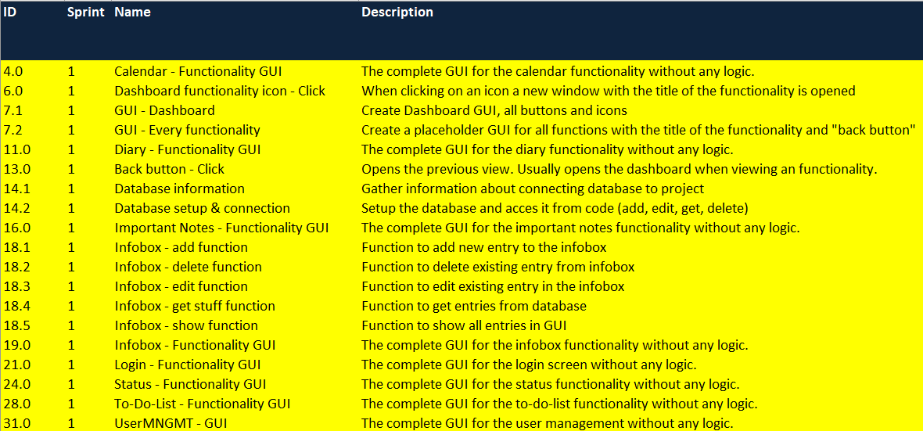
Sprint Backlog

Slide 10
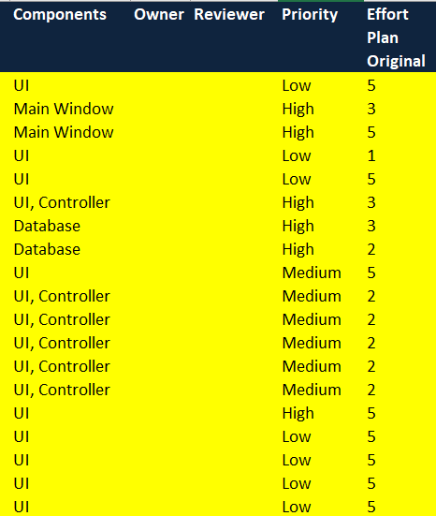
Sprint Backlog
Total: 67 h

Slide 11

Thank you very much for your attention!
We are happy to answer any open questions.

